Slide 1
Unit-1 Requirement
Analysis & Specification
-KRISHNA BRAHMBHATT
Reference Book:
Software Engineering -A Practitioner’s Approach (Seventh Edition) - Roger S. Pressman.
Chapter 5:Understanding Requirements

Slide 2



Requirements analysis is hard
“The hardest single part of building a software system is deciding what to build. No part of the work so cripples the
resulting system if done wrong.”
“The seeds of major software disasters are usually sown in the
first three months of commencing the software project.”
What is Requirement Engineering?
Tasks and techniques that lead to an understanding of requirements is called requirement engineering.
"Fred" Brooks Jr. is an American computer architect, software engineer, and computer scientist, best known for managing the development of IBM's System/360 family of computers
Capers Jones is an American specialist in software engineering methodologies

Slide 3
User requirements to mean the high-level abstract requirements
Often referred to as user needs.
Such as what activities that users must be able to perform using the system.
User requirements are generally documented in a User Requirements Document (URD) using narrative text.
User requirements are generally signed off by the user and used as the primary input for creating system requirements.
An important and difficult step of designing a software product is determining what the user actually wants it to do.
This is because the user is often not able to communicate the entirety of their needs and wants, and the information they provide may also be incomplete, inaccurate and self-conflicting.

Slide 4
System requirements to mean the detailed description of what the system should do.
System requirements are the building blocks developers use to build the system.
These are the traditional “shall” statements that describe what the system “shall do.”
System requirements are classified as either functional or supplemental requirements/non-functional requirements.
A functional requirement specifies something that a user needs to perform their work. For example, a system may be required to enter and print cost estimates; this is a functional requirement.
Supplemental or non-functional requirements are sometimes called quality of service requirements.

Slide 5
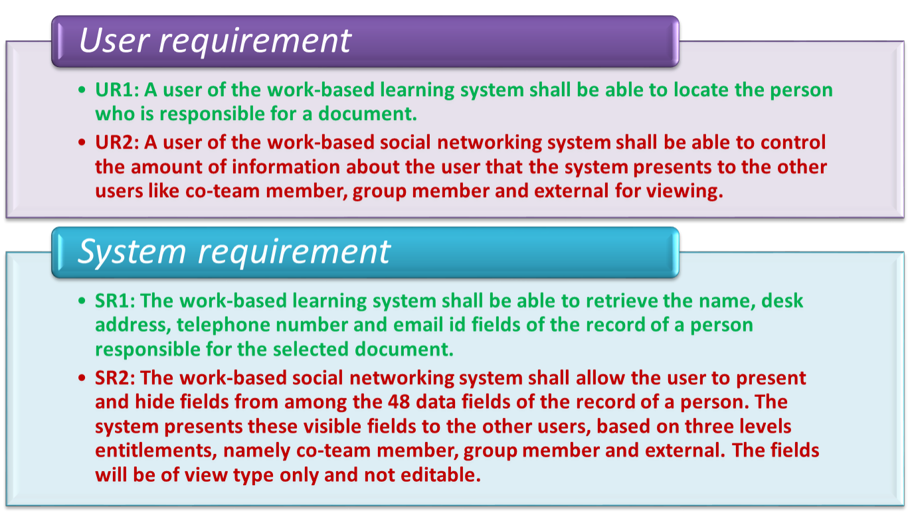

Slide 6
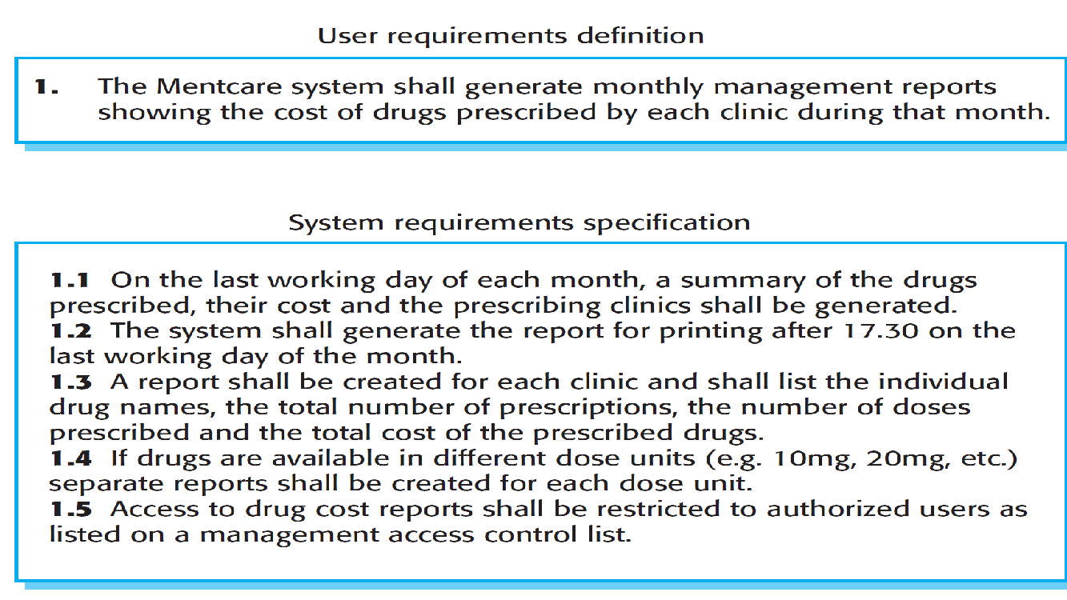

Slide 7
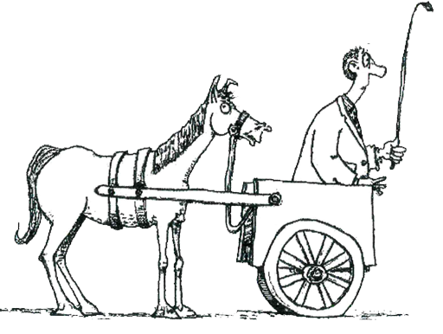
Requirement Engineering
It provides the appropriate mechanism for understanding
Requirements fall into two types
Functional requirements
Non-Functional requirements
What customer wants
Non-Functional requirements
Functional requirements
Analyzing needs
Assessing feasibility
Negotiating a reasonable solution
Specifying solution unambiguously
Validating the specification
Managing requirements
Don't put what you want to do - before how you need to do it

Slide 8
Functional requirements
Non-functional requirements
Any requirement which specifies what the system Should do.
Any requirement which specifies how the system performs a certain function.
A functional requirement will describe a particular behavior of function of the system when certain conditions are met, for example: “Send email when a new customer signs up” or “Open a new account”.
A non-functional requirement will describe how a system should behave and what limits there are on its functionality.
Typical functional requirements
Typical non-functional requirements
Business Rules
Administrative functions
Historical Data
Response time
Availability
Regulatory
Transaction corrections, adjustments and cancellations
Legal or Regulatory Requirements
Throughput
Reliability
Manageability
Utilization
Recoverability
Environmental
External Interfaces
Reporting Requirements
Authentication
Static volumetric
Maintainability
Data Integrity
Authorization levels
Scalability
Serviceability
Usability
Audit Tracking
Capacity
Security
Interoperability

Slide 9
Library Management System
Function Requirements
Non-function Requirements
Add Article: New entries must be entered in database
Update Article: Any changes in articles should be updated in case of update
Delete Article: Wrong entry must be removed from system
Inquiry Members: Inquiry all current enrolled members to view their details
Inquiry Issuance: Inquiry all database articles
Check out Article: To issue any article must be checked out
Check In article: After receiving any article system will reenter article by Checking
Inquiry waiting for approvals: Librarian will generate all newly application which is in waiting list
Reserve Article: This use case is used to reserve any book with the name of librarian, it can be pledged
Safety Requirements: The database may get crashed at any certain time due to virus or operating system failure. So, it is required to take the database backup.
Security Requirements: We are going to develop a secured database for the university. There are different categories of users namely teaching staff, administrator, library staff ,students etc., Depending upon the category of user the access rights are decided.
Software Constraints: The development of the system will be constrained by the availability of required software such as database and development tools. The availability of these tools will be governed by

Slide 10
Feasibility studies
A feasibility study is a short, focused study that should take place early in the RE process. It should answer three key questions:
Does the system contribute to the overall objectives of the organization?
Can the system be implemented within schedule and budget using current technology?
Can the system be integrated with other systems that are used?
If the answer to any of these questions is no, you should probably not go ahead with the project.

Slide 11



Requirements Engineering Tasks
1
Inception
2
Elicitation (Requirement Gathering)
3
Elaboration
Roughly define scope
Define requirements
Further define requirements
A basic understanding of a problem, people who want a solution, the nature of solution desired
The practice of collecting the requirements of a system from users, customers and other stakeholders
Expand and refine requirements obtained from inception & elicitation
Creation of User scenarios, extract analysis class and business domain entities

Slide 12


Requirements Engineering Tasks Cont.
4
Negotiation
5
Specification
Reconcile conflicts
Create analysis model
Agree on a deliverable system that is realistic for developers and customers
It may be written document, set of graphical models, formal mathematical model, collection of user scenarios, prototype or collection of these
SRS (Software Requirement Specification) is a document that is created when a detailed description of all aspects of software to build must be specified before starting of project

Slide 13


Requirements Engineering Tasks Cont.
6
Validation
7
Requirements Management
Ensure quality of requirements
It is a set of activities to identify, control & trace requirements & changes to requirements (Umbrella Activities) at any time as the project proceeds.
Review the requirements specification for errors, ambiguities, omissions (absence) and conflicts

Slide 14



Elicitation is the Hardest Part!
Project Inception
Problems of scope
System boundaries are ill-defined
Customers will provide irrelevant information
Problems of understanding
Customers never know exactly what they want
Customers don’t understand capabilities and limitations
Customers have trouble fully communicating needs
Problems of volatility
Requirements always change
During the initial project meetings, the following tasks should be accomplished
Identify the project stakeholders
These are the folks we should be talking to
Recognize multiple viewpoints
Stakeholders may have different (and conflicting) requirements
Work toward collaboration
It’s all about reconciling conflict
Ask the first questions
Who? What are the benefits? Another source?
What is the problem? What defines success? Other constraints?
Am I doing my job right?

Slide 15


Collaborative Elicitation
Elicitation work products
Collaborative elicitation should result in several work products
A bounded statement of scope
A list of stakeholders
A description of the technical environment
A list of requirements and constraints
Any prototypes developed
A set of use cases
Characterize how users will interact with the system
Use cases tie functional requirements together
One-on-one Q&A sessions rarely succeed in practice; collaborative strategies are more practical

Slide 16
Quality Function Deployment (QFD)
This is a technique that translates the needs of the customer into technical requirements for software
It emphasizes an understanding of what is valuable to the customer and then deploys these values throughout the engineering process through functions, information, and tasks
It identifies three types of requirements
Normal requirements: These requirements are the objectives and goals stated for a product or system during meetings with the customer
Expected requirements: These requirements are implicit to the product or system and may be so fundamental that the customer does not explicitly state them
Exciting requirements: These requirements are for features that go beyond the customer's expectations and prove to be very satisfying when present

Slide 17


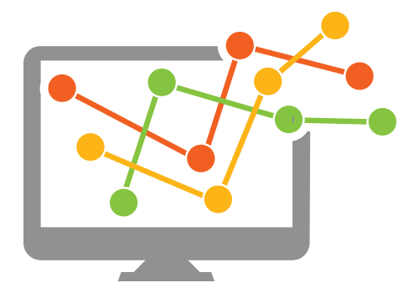
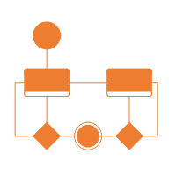
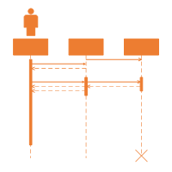
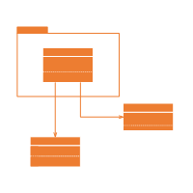
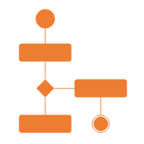
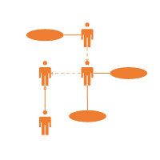
The requirement analysis model
Describe what the customer wants to built
System Information
Purpose
Establish the foundation for the software design
System Function
Provide a set of validation requirements
System Behaviors

Slide 18

Analysis rule of Thumb
Elements of the Requirements Model
Make sure all points of view are covered
Every element should add value
Keep it simple
Maintain a high level of abstraction
Focus on the problem domain
Minimize system coupling
Model should provide value to all stakeholders
Scenario-based Models
e.g.
Use cases
User Stories
Class Models
e.g.
Class diagrams
Collaboration diagrams
Software
Requirements
Behavioral Models
e.g.
State diagrams
Sequence diagrams
Flow Models
e.g.
DFDs
Data models

Slide 19
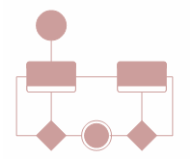
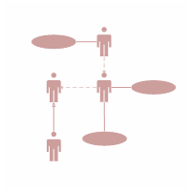
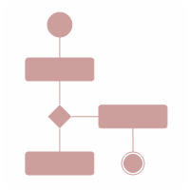
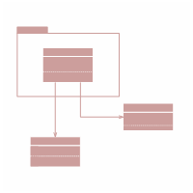
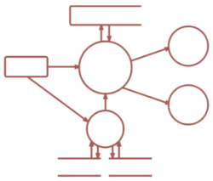
Elements of the Requirements Model Cont.
Scenario-based elements
Behavioral elements
Describe the system from the user's point of view using scenarios that are depicted (stated) in use cases and activity diagrams
Use state diagrams to represent the state of the system, the events that cause the system to change state, and the actions that are taken as a result of a particular event. This can also be applied to each class in the system.
Class-based elements
Identify the domain classes for the objects manipulated by the actors, the attributes of these classes, and how they interact with one another; which utilize class diagrams to do this.
Flow-oriented elements
Use data flow diagrams to show the input data that comes into a system, what functions are applied to that data to do transformations, and what resulting output data are produced.
Use Case Diagram
Activity Diagram
Class Diagram
State Diagram
Data Flow Diagram

Slide 20

Analysis Modeling Approaches
Structured Analysis
Object Oriented Analysis
Models data elements
Attributes
Relationships
Models processes that transform data
Model analysis classes
Data
Processes
Models class collaborations
Techniques from both approaches are typically used in practice.

Slide 21
List of documentation & manuals
Formal Specification
Documentation Manuals
Analysis / Specification
Context Diagram
Data Flow Diagram
User Manuals
Operational Manuals
Flow Charts
Design
Documentation Manuals
ER Diagram
System Overview
Installation Guide
Source Code Listings
Implementation
Beginner’s Guide Tutorials
Cross-Reference Listings
System Administration Guide
Test Data
Reference Guide
Testing
Test Results

Slide 22
SRS (Software Requirements Specification)
Software Requirement Specification (SRS) is a document that completely describes what the proposed software should do without describing how software will do it.
SRS is also helping the clients to understand their own needs.
SRS Contains
A complete information description
A detailed functional description
A representation of system behaviour
An indication of performance requirements and design constraints
Appropriate validation criteria
Other information suitable to requirements

Slide 23
Characteristics of a Good SRS
SRS should be accurate, complete, efficient, and of high quality, so that it does not affect the entire project plan.
An SRS is said to be of high quality when the developer and user easily understand the prepared document.
Characteristics of a Good SRS:
Correct
Unambiguous
Complete
SRS is correct when all user requirements are stated in the requirements document.
SRS is unambiguous when every stated requirement has only one interpretation.
SRS is complete when the requirements clearly define what the software is required to do.
Note that there is no specified tool or procedure to assure the correctness of SRS.

Slide 24
Characteristics of a Good SRS Cont.
Ranked for Importance/Stability
Modifiable
All requirements are not equally important, hence each requirement is identified to make differences among other requirements.
The requirements of the user can change, hence requirements document should be created in such a manner that those changes can be modified easily.
Stability implies the probability of changes in the requirement in future.
Traceable
Verifiable
Consistent
SRS is traceable when the source of each requirement is clear and facilitates the reference of each requirement in future.
SRS is verifiable when the specified requirements can be verified with a cost-effective process to check whether the final software meets those requirements.
SRS is consistent when the subsets of individual requirements defined do not conflict with each other.

Slide 25
Problems Without SRS
Without developing the SRS document, the system would not be properly implemented according to customer needs.
Software developers would not know whether what they are developing is what exactly is required by the customer.
Without SRS, it will be very difficult for the maintenance engineers to understand the functionality of the system.
It will be very difficult for user document writers to write the users’ manuals properly without understanding the SRS.

Slide 26
Standard Template for writing SRS
1. Introduction
1.1 Purpose
1.2 Document Conventions
1.3 Intended Audience and Reading Suggestions
1.4 Project Scope
1.5 References
2. Overall Description
2.1 Product Perspective
2.2 Product Features
2.3 User Classes and Characteristics
2.4 Operating Environment
2.5 Design and Implementation Constraints
2.6 User Documentation
2.7 Assumptions and Dependencies
3. System Features
3.1 System Feature 1
3.2 System Feature 2 (and so on)
4. External Interface Requirements
4.1 User Interfaces
4.2 Hardware Interfaces
4.3 Software Interfaces
4.4 Communications Interfaces
5. Other Non-functional Requirements
5.1 Performance Requirements
5.2 Safety Requirements
5.3 Security Requirements
5.4 Software Quality Attributes
6. Other Requirements
Appendix A: Glossary | Appendix B: Analysis Models | Appendix C: Issues List

